Slide 1
Intro to Cloud Computing CS4037 (BCS-6A) Lecture 06
Danyal Farhat
FAST School of Computing
NUCES Lahore

Slide 2
Module 4: AWS Cloud Security
AWS Academy Cloud Foundations

Slide 3
Module overview
Topics
AWS shared responsibility model
AWS Identity and Access Management (IAM)
Securing a new AWS account
Securing accounts
Securing data on AWS
Working to ensure compliance
Activities
AWS shared responsibility model activity
Lab
Introduction to AWS IAM

Slide 4
Module objectives
After completing this module, you should be able to:
Recognize the shared responsibility model
Identify the responsibility of the customer and AWS
Recognize IAM users, groups, and roles
Describe different types of security credentials in IAM
Identify the steps to securing a new AWS account
Explore IAM users and groups
Recognize how to secure AWS data
Recognize AWS compliance programs

Slide 5
Section 1: AWS shared responsibility model
Module 4: AWS Cloud Security

Slide 6
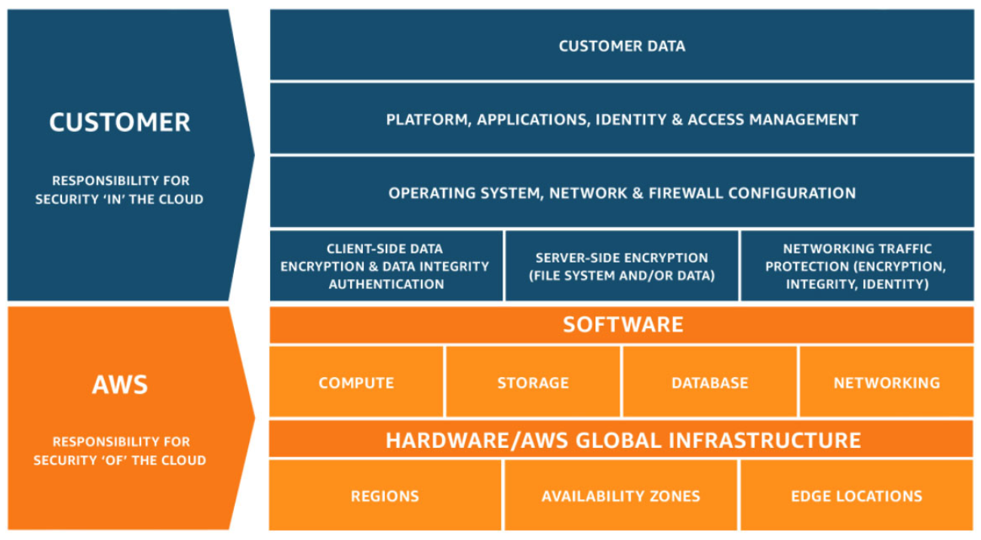
AWS shared responsibility model

Slide 7








AWS responsibility: Security of the cloud
AWS responsibilities:
Physical security of data centers
Controlled, need-based access
Hardware and software infrastructure
Storage decommissioning, host operating system (OS) access logging, and auditing
Network infrastructure
routers, switches, load balancers, firewalls, and cabling
Redundant infra & Intrusion detection
Virtualization infrastructure
Instance isolation
AWS Audit Reports
AWS services
Compute
Storage
Database
Networking
AWS Global Infrastructure
Regions
Availability Zones
Edge locations
Notes:
Protecting this infrastructure is the top priority for AWS. While you cannot visit AWS data centers or offices to see this protection firsthand, Amazon provides several reports from third-party auditors who have verified our compliance with a variety of computer security standards and regulations.

Slide 8
Customer responsibility: Security in the cloud
Customer responsibilities:
Amazon Elastic Compute Cloud (Amazon EC2) instance operating system
Including patching, maintenance
Applications
Passwords, role-based access, etc.
Security group configuration
OS or host-based firewalls
Including intrusion detection or prevention systems
Network configurations
Account management
Login and permission settings for each user
Customer data
Applications, IAM
Operating system, network, and firewall configuration
Client-side data
encryption and data integrity authentication
Server-side encryption
(file system or data)
Network traffic protection
(encryption, integrity, identity)
Customer-configurable

Slide 9






Service characteristics and security responsibility (1 of 2)
Example services managed by the customer
Infrastructure as a service (IaaS)
Customer has more flexibility over configuring networking and storage settings
Customer is responsible for managing more aspects of the security
Customer configures the access controls
Platform as a service (PaaS)
Customer does not need to manage the underlying infrastructure
AWS handles the operating system, database patching, firewall configuration, and disaster recovery
Customer can focus on managing code or data
Amazon EC2
Amazon Elastic Block Store (Amazon EBS)
Amazon Virtual Private Cloud (Amazon VPC)
Example services managed by AWS
AWS Lambda
Amazon Relational Database Service (Amazon RDS)
AWS Elastic Beanstalk

Slide 10



Service characteristics and security responsibility (2 of 2)
SaaS examples
Software as a service (SaaS)
Software is centrally hosted
Licensed on a subscription model or pay-as-you-go basis.
Services are typically accessed via web browser, mobile app, or application programming interface (API)
Customers do not need to manage the infrastructure that supports the service
SaaS Example
AWS Trusted
Advisor
AWS Shield
Amazon Chime
Notes:
AWS Trusted Advisor is an online tool that analyzes your AWS environment and provides real-time guidance and recommendations to help you provision your resources by following AWS best practices.
AWS Shield is a managed distributed denial of service (DDoS) protection service that safeguards applications running on AWS.
Amazon Chime is a communications service that enables you to meet, chat, and place business calls inside and outside your organization, all using a single application. It is a pay-as-you-go communications service with no upfront fees, commitments, or long-term contracts.

Slide 11

Activity: AWS shared responsibility model
Photo by Pixabay from Pexels.

Slide 12




Activity: Scenario 1 of 2
Consider this deployment. Who is responsible – AWS or the customer?
AWS Cloud
Upgrades and patches to the operating system on the EC2 instance?
Physical security of the data center?
Virtualization infrastructure?
EC2 security group settings?
Configuration of applications that run on the EC2 instance?
Oracle upgrades or patches If the Oracle instance runs as an Amazon RDS instance?
Oracle upgrades or patches If Oracle runs on an EC2 instance?
S3 bucket access configuration?
Virtual Private Cloud (VPC)
Amazon Simple Storage Service (Amazon S3)
Amazon EC2
Oracle instance
AWS Global Infrastructure

Slide 13
Activity: Scenario 1 of 2 Answers
Consider this deployment. Who is responsible – AWS or the customer?
AWS Cloud
Upgrades and patches to the operating system on the EC2 instance?
Customer
Physical security of the data center?
AWS
Virtualization infrastructure?
AWS
EC2 security group settings?
Customer
5. Configuration of applications that run on the EC2 instance?
Customer
Oracle upgrades or patches If the Oracle instance runs as an Amazon RDS instance?
AWS
Oracle upgrades or patches If Oracle runs on an EC2 instance?
Customer
S3 bucket access configuration?
Customer
Virtual Private Cloud (VPC)
Amazon Simple Storage Service (Amazon S3)
Amazon EC2
Oracle instance
AWS Global Infrastructure

Slide 14







Activity: Scenario 2 of 2
Consider this deployment. Who is responsible – AWS or the customer?
Secure Shell (SSH) keys
Ensuring that the AWS Management Console is not hacked?
Configuring the subnet?
Configuring the VPC?
Protecting against network outages in AWS Regions?
Securing the SSH keys
Ensuring network isolation between AWS customers' data?
Ensuring low-latency network connection between the web server and the S3 bucket?
Enforcing multi-factor authentication for all user logins?
AWS Command Line Interface (AWS CLI)
AWS Management Console
Internet gateway
VPC
Subnet
Web server on Amazon EC2
S3 bucket with objects

Slide 15
Activity: Scenario 2 of 2 Answers
Consider this deployment. Who is responsible – AWS or the customer?
Secure Shell (SSH) keys
Ensuring that the AWS Management Console is not hacked?
AWS
Configuring the subnet?
Customer
Configuring the VPC?
Customer
Protecting against network outages in AWS Regions?
AWS
Securing the SSH keys
Customer
Ensuring network isolation between AWS customers' data?
AWS
Ensuring low-latency network connection between the web server and the S3 bucket?
AWS
Enforcing multi-factor authentication for all user logins?
Customer
AWS Command Line Interface (AWS CLI)
AWS Management Console
Internet gateway
VPC
Subnet
Web server on Amazon EC2
S3 bucket with objects

Slide 16

Section 1 key takeaways
AWS and the customer share security responsibilities:
AWS is responsible for security of the cloud
Customer is responsible for security in the cloud
AWS is responsible for protecting the infrastructure—including hardware, software, networking, and facilities—that run AWS Cloud services
For services that are categorized as infrastructure as a service (IaaS), the customer is responsible for performing necessary security configuration and management tasks
For example, guest OS updates and security patches, firewall, security group configurations

Slide 17
Section 2: AWS Identity and Access Management (IAM)
Module 4: AWS Cloud Security

Slide 18

AWS Identity and Access Management (IAM)
Use IAM to manage access to AWS resources –
A resource is an entity in an AWS account that you can work with
Example resources; An Amazon EC2 instance or an Amazon S3 bucket
Example – Control who can terminate Amazon EC2 instances
Define fine-grained access rights –
Who can access the resource
Which resources can be accessed and what can the user do to the resource
How resources can be accessed
Provides authentication and authorization
IAM is a no-cost AWS account feature
AWS Identity and Access Management
(IAM)

Slide 19




IAM: Essential components
A person or application that can authenticate with an AWS account.
IAM user
A collection of IAM users that are granted identical authorization.
IAM group
The document that defines which resources can be accessed and the level of access to each resource.
IAM policy
Useful mechanism to grant a set of permissions for making AWS service requests.
IAM role

Slide 20

Authenticate as an IAM user to gain access
When you define an IAM user, you select what types of access the user is permitted to use.
Programmatic access
Authenticate using:
Access key ID
Secret access key
Provides AWS CLI and AWS SDK access
AWS Management Console access
Authenticate using:
12-digit Account ID or alias
IAM user name
IAM password
If enabled, multi-factor authentication (MFA) prompts for an authentication code.
AWS CLI
AWS Tools and SDKs
AWS Management Console

Slide 21

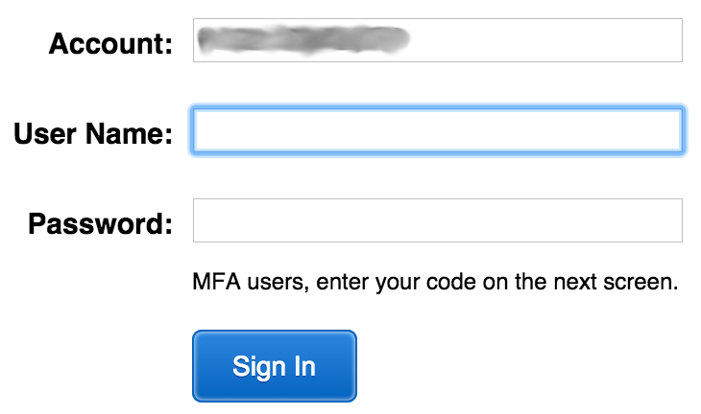

IAM MFA
MFA provides increased security.
In addition to username and password, MFA requires a unique authentication code to access AWS services.
Username and password
MFA token
AWS Management Console

Slide 22



Authorization: What actions are permitted
After the user or application is connected to the AWS account, what are they allowed to do?
EC2 instances
Full access
Read-only
IAM user, IAM group, or IAM role
S3 bucket
IAM policies

Slide 23
IAM: Authorization
Assign permissions by creating an IAM policy.
Permissions determine which resources and operations are allowed:
All permissions are implicitly denied by default.
If something is explicitly denied, it is never allowed.
Best practice: Follow the principle of least privilege.
Note: The scope of IAM service configurations is global. Settings apply across all AWS Regions.
IAM permissions

Slide 24
IAM policies
An IAM policy is a document that defines permissions
Enables fine-grained access control
Two types of policies – identity-based and resource-based
Identity-based policies –
Attach a policy to any IAM entity
An IAM user, an IAM group, or an IAM role
Policies specify:
Actions that may be performed by the entity
Actions that may not be performed by the entity
A single policy can be attached to multiple entities
A single entity can have multiple policies attached to it
Resource-based policies
Attached to a resource (such as an S3 bucket)
IAM entities
Attach to one of
IAM user
IAM policy
IAM group
IAM role

Slide 25

IAM policy example
{
"Version": "2012-10-17",
"Statement":[{
"Effect":"Allow",
"Action":["DynamoDB:*","s3:*"],
"Resource":[ "arn:aws:dynamodb:region:account-number-without-hyphens:table/table-name",
"arn:aws:s3:::bucket-name",
"arn:aws:s3:::bucket-name/*"]
},
{
"Effect":"Deny",
"Action":["dynamodb:*","s3:*"],
"NotResource":["arn:aws:dynamodb:region:account-number-without-hyphens:table/table-name”,
"arn:aws:s3:::bucket-name",
"arn:aws:s3:::bucket-name/*"]
}
]
}
Explicit allow gives users access to a specific DynamoDB table and…
…Amazon S3 buckets.
Explicit deny ensures that the users cannot use any other AWS actions or resources other than that table and those buckets.
An explicit deny statement takes precedence over an allow statement.
Notes:
As mentioned previously, IAM policy documents are written in JSON.
The example IAM policy grants users access only to the following resources:
The DynamoDB table whose name is represented by table-name.
The AWS account's S3 bucket, whose name is represented by bucket-name and all the objects that it contains.
The IAM policy also includes an explicit deny ("Effect":"Deny") element. The NotResource element helps to ensure that users cannot use any other DynamoDB or S3 actions or resources except the actions and resources that are specified in the policy—even if permissions have been granted in another policy. An explicit deny statement takes precedence over an allow statement.

Slide 26


Resource-based policies
Identity-based policies are attached to a user, group, or role
Resource-based policies are attached to a resource (not to a user, group or role)
Characteristics of resource-based policies –
Specifies who has access to the resource and what actions they can perform on it
The policies are inline only, not managed
Resource-based policies are supported only by some AWS services
AWS Account
IAM user MaryMajor
S3 bucket photos
attached
Defined inline
on the bucket
Identity-based policy
Resource-based policy
Policy grants list, read objects to the photos bucket
Policy grants user MaryMajor list, read objects
Notes:
Resource-based policies are defined inline only, which means that you define the policy on the resource itself, instead of creating a separate IAM policy document that you attach.

Slide 27
IAM permissions
How IAM determines permissions:
Is the permission explicitly denied ?
Is the permission explicitly allowed ?
No
No
Deny
Implicit deny
Yes
Yes
Deny
Allow

Slide 28
IAM groups
An IAM group is a collection of IAM users
A group is used to grant the same permissions to multiple users
Permissions granted by attaching IAM policy or policies to the group
A user can belong to multiple groups
There is no default group
Groups cannot be nested
AWS account
IAM group:
Admins
IAM group:
Developers
IAM group:
Testers
Carlos Salazar
Li Juan
Zhang Wei
Márcia Oliveira
Mary Major
John Stiles
Richard Roe
Li Juan

Slide 29
IAM roles
An IAM role is an IAM identity with specific permissions
Similar to an IAM user
Attach permissions policies to it
Different from an IAM user
Not uniquely associated with one person
Intended to be assumable by a person, application, or service
Role provides temporary security credentials
Examples of how IAM roles are used to delegate access –
Used by an IAM user in the same AWS account as the role
Used by an AWS service—such as Amazon EC2—in the same account as the role
Used by an IAM user in a different AWS account than the role
IAM role

Slide 30


Example use of an IAM role
Scenario:
An application that runs on an EC2 instance needs access to an S3 bucket
Solution:
Define an IAM policy that grants access to the S3 bucket.
Attach the policy to a role
Allow the EC2 instance to assume the role
AWS Cloud
Application has permissions to access the S3 bucket
Amazon EC2 instance
Application
3
Amazon S3 bucket photos
Role assumed by the EC2 instance
2
attached
IAM role
1
IAM policy grants access to photos bucket

Slide 31
Section 2 key takeaways
IAM policies are constructed with JavaScript Object Notation (JSON) and define permissions.
IAM policies can be attached to any IAM entity.
Entities are IAM users, IAM groups, and IAM roles.
An IAM user provides a way for a person, application, or service to authenticate to AWS.
An IAM group is a simple way to attach the same policies to multiple users.
An IAM role can have permissions policies attached to it and can be used to delegate temporary access to users or applications.

Slide 32
Section 3: Securing a new AWS account
Module 4: AWS Cloud Security

Slide 33

AWS account root user access versus IAM access
Account root user
IAM
Best practice: Do not use the AWS account root user except when necessary.
Access to the account root user requires logging in with the email address (and password) that you used to create the account.
Example actions that can only be done with the account root user:
Update the account root user password
Change the AWS Support plan
Restore an IAM user's permissions
Change account settings (for example, contact information, allowed Regions)
Integrates with other AWS services
Identity federation
Privileges cannot be controlled
Secure access for applications
Full access to all resources
Granular permissions

Slide 34
Securing a new AWS account: Account root user
Step 1: Stop using the account root user as soon as possible.
The account root user has unrestricted access to all your resources.
To stop using the account root user:
While you are logged in as the account root user, create an IAM user for yourself. Save the access keys if needed.
Create an IAM group, give it full administrator permissions, and add the IAM user to the group.
Disable and remove your account root user access keys, if they exist.
Enable a password policy for users.
Sign in with your new IAM user credentials.
Store your account root user credentials in a secure place.

Slide 35
Securing a new AWS account: MFA
Step 2: Enable multi-factor authentication (MFA).
Require MFA for your account root user and for all IAM users.
You can also use MFA to control access to AWS service APIs.
Options for retrieving the MFA token –
Virtual MFA-compliant applications:
Google Authenticator.
Authy Authenticator (Windows phone app).
U2F security key devices:
For example, YubiKey.
Hardware MFA options:
Key fob or display card offered by Gemalto.
MFA token

Slide 36
Securing a new AWS account: AWS CloudTrail
Step 3: Use AWS CloudTrail.
CloudTrail tracks user activity on your account.
Logs all API requests to resources in all supported services your account.
Enables operational auditing on your account.
Basic AWS CloudTrail event history is enabled by default and is free.
It contains all management event data on latest 90 days of account activity.
To access CloudTrail –
Log in to the AWS Management Console and choose the CloudTrail service.
Click Event history to view, filter, and search the last 90 days of events.
To enable logs beyond 90 days and enable specified event alerting, create a trail.
From the CloudTrail Console trails page, click Create trail.
Give it a name, apply it to all Regions, and create a new Amazon S3 bucket for log storage.
Configure access restrictions on the S3 bucket (for example, only admin users should have access).

Slide 37
Securing a new AWS account: Billing reports
Step 4: Enable a billing report, such as the AWS Cost and Usage Report.
Billing reports provide information about your use of AWS resources and estimated costs for that use.
AWS delivers the reports to an Amazon S3 bucket that you specify.
Report is updated at least once per day.
The AWS Cost and Usage Report tracks your AWS usage and provides estimated charges associated with your AWS account, either by the hour or by the day.

Slide 38
Section 3 key takeaways
Best practices to secure an AWS account:
Secure logins with multi-factor authentication (MFA).
Delete account root user access keys.
Create individual IAM users and grant permissions according to the principle of least privilege.
Use groups to assign permissions to IAM users.
Configure a strong password policy.
Delegate using roles instead of sharing credentials.
Monitor account activity by using AWS CloudTrail.

Slide 39
Thank you
All trademarks are the property of their owners.

